Slide 1
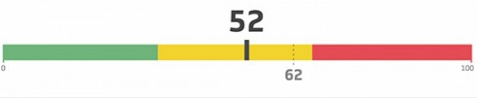



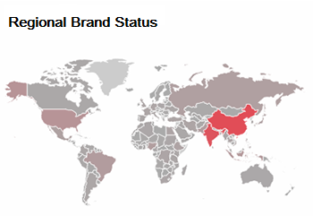
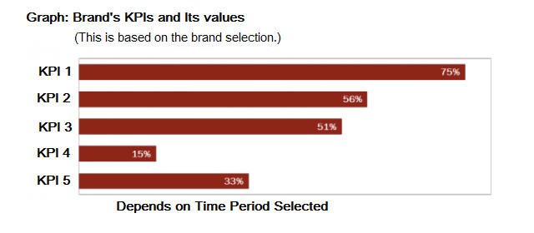
Brand Analytics Dashboard
Time Period
(Click on required time period to get selected period’s statistics. By default everything will be considered.)
6 Months
1 Month
2 Weeks
1 Week
Procter & Gamble
Brands
ARIEL
JOY
DOWNY
FEBREZE

Slide 2
List of KPIs Identified
Net Promoter Score
Customer Satisfaction Index
Loyalty / Customer Preference
Quality Index
First time through
Brand Price sensitivity
Availability
Trend Index(Based on No. of Customer reviewed)

